Slide 1
To share file on Rpi with our system
$ Pscp Book.xlsx iota@10.3.141.1:esp32

Slide 2
To update file on Rpi with our system
Samba installed using terminal on Rpi
$ sudo apt install samba samba-common-bin
Share the folder from Rpi home directory, below command will give home directory
$ ls ~/
$ ls /home/iota
$ mkdir ~/shared
Pi Network File Share to Windows & More | Pi NAS/SMB | Raspberry Pi Guide (youtube.com)

Slide 3
Add below things in file
$ sudo nano /etc/samba/smb.conf
[shared]
path =/home/iota/shared
writeable=Yes
create mask=0666
directory mask =0666
public=no
Note: you can give 0777 instead of 0666 to give permission to read and write to anyone

Slide 4
Set the password for the samba
$ sudo smbpasswd –a iota
and give the password
$ sudo systemctl restart smbd
Get the IP of the RPI
$ hostname -I

Slide 5
How to write sensor data in CSV file
# open the csv file
file = open(“log.csv”,”a”)
file.write(str(msg.payload)[7:17]+”,”)
How to Write Data to a File on the Raspberry Pi - Circuit Basics %

Slide 6
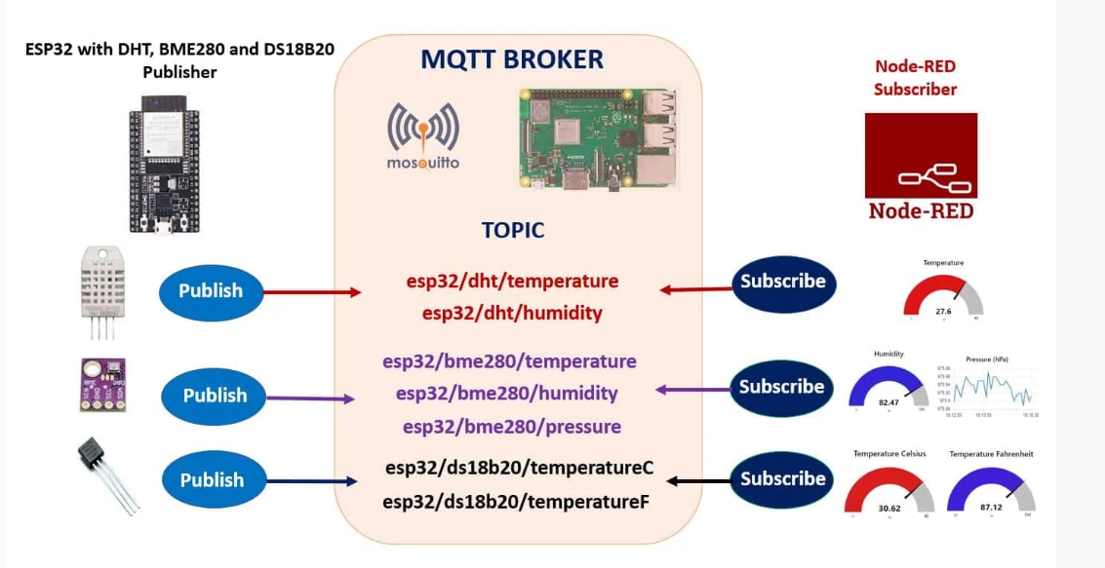

Slide 7
LED CSV ON NODE RED
LINK:
https://flows.nodered.org/flow/5bca514f463320c82ad7aecce6457193

